Slide 1

Lesson 3.01: Built-In Functions
Microsoft Philanthropies TEALS Program
Introduction to Computer Science
Semester 2

Slide 2
Built-In Functions
After this lesson, you will be able to...
Define and identify function, argument, calling, importing, returning
Call the built-in randint function, using arguments
Utilize code other people have written in Python libraries
Understand the difference between printing and returning

Slide 3
Today’s Plan
Do Now
Lesson
Lab
Debrief

Slide 4
Do Now
Write down in your notebook one thing you learned in the previous class.
Type the following code into the editor and run the program.
import random
print(random.randint(0, 3))
print(random.randint(0, 3))
print(random.randint(0, 3))
1) What does randint do?
2) What do the 0 and 3 do? Try changing those numbers and re-run the program.
3) Try typing the same lines above, directly into the Python console, hitting Enter after each line. What is different about executing code in interactive mode?
4) What happens if you leave out the print() command, and instead just type random.randint(0, 3) into the console?
5) What happens differently if you remove print() from one or more lines in the original program above, and re-run that? Why does that happen?
Notes:
Give students 3-4 minutes to follow the instructions on the Do Now page.
Most console interfaces will allow the same command line to be executed again, by pressing the up arrow followed by [Enter].
Debrief the answers to the questions on the Do Now by calling on students to respond.
The last three questions are a reminder about how interactive mode works in the console, as opposed to how a Python program works when it's running (Unit 1.02).

Slide 5
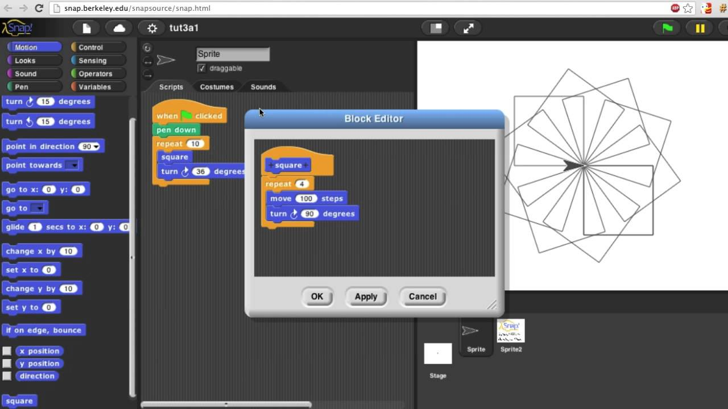
Remember – Building your own block in Snap
Notes:
Remind students of creating a block in Snap!

Slide 6
Definitions
A function is a named sequence of statements.
You can call the function by its function name.
Expect a set of arguments defined by whoever designed them
How to determine what the arguments are? Documentation!
To find the documentation for Python, you can search on your favorite search engine.
What are some built-in functions we’ve seen?
print()
type()
randint()
len()
input()
str()
int()
float()
bool()
Notes:
You can use functions to perform complex calculations, graphical operations, and various other purposes. When you define a function, you specify the name and the sequence of statements.
You tell the programmer what elements the function expects (name and type of arguments) and the function will perform its purpose. It is good practice to use a comment to specify the purpose and contract of a function, including the type of value it returns, if it returns a value.

Slide 7
Parts of a function written in Python
x = somefunction(a, b, c)
Returned value is saved to x
Name of the Function
Arguments
Notes:
Talk about the different components of a function.

Slide 8

Lab 3.01: What is the Magic 8 Ball?
Notes:
Lab 03.01 - https://tealsk12.gitbook.io/intro-cs-2/unit_3/lesson/lab
The first part of the video explains how the Magic 8 Ball works and then the rest of video speaks directly to coding the Magic 8-Ball.

Slide 9
Lab 3.01: Magic 8-Ball
Practice importing random
Use randint with different arguments.
Simulate a dice roll, printing out to the user what number they rolled.
Look at the documentation of the random library
Experiment with another function (not randint) that returns a value.
Create a program that simulates a Magic 8-Ball —
Store all of the 8-Ball's possible responses (shown on the next slide) in a list.
Prompt the user to ask the Magic 8-Ball a question
Return and print a random response.
Notes:
Wikipedia - https://en.wikipedia.org/wiki/Magic_8-Ball
Documentation link - https://docs.python.org/3/library/random.html

Slide 10
Magic 8-Ball Response List
Outlook is good
Ask again later
Yes
No
Most likely no
Most likely yes
Maybe
Outlook is not good

Slide 11
Bonus
Research the math library in Python.
Create a program that finds the length of the hypotenuse of a right triangle, given the two perpendicular sides.
Can this program be completed without using import math?
Notes:
Can this program be completed without using 'import math'? -- Yes, the exponentiation operator can find square roots: x**0.5 is equivalent to math.sqrt(x) , and 'import math' is not needed to access the ** operator.

Slide 12
Exit Ticket
In your notebook, write down two things you learned today.

